Slide 1
Make Your Own Wreck This Journal
Let’s get inspired.

Slide 2

But first…a game!
Mind Readers

Slide 3
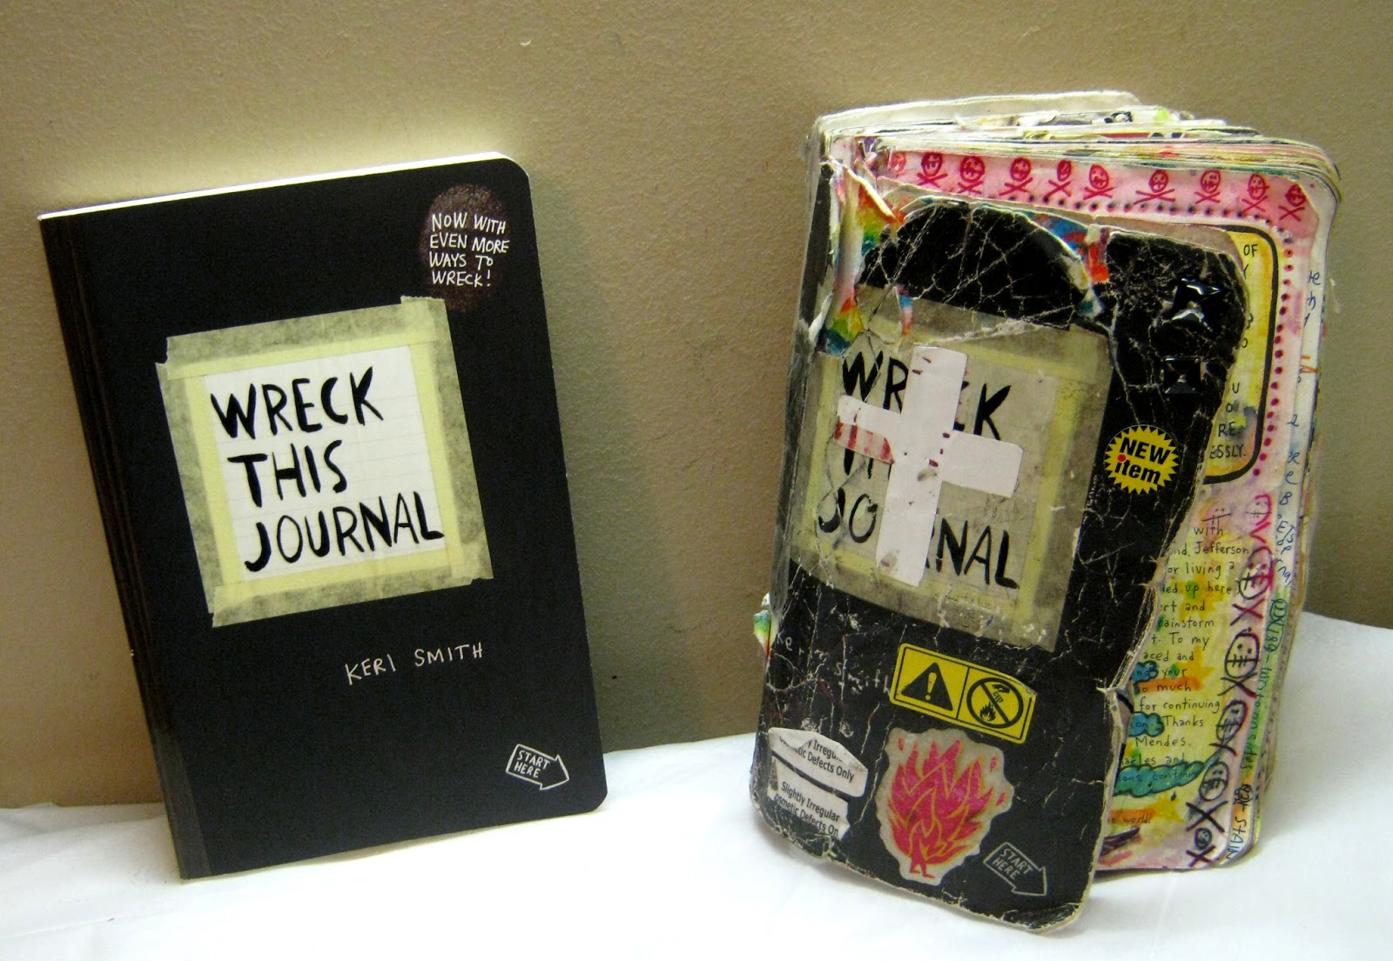
What is Wreck This Journal?
A series of books by genius and weirdo Kerri Smith.
Every page has unique instructions on it for the reader to complete
For example: turn a coffee stain into a monster, or “Collect Fruit Stickers Here”
People have done some pretty awesome/strange stuff with their journals.
Photo from: www.trinaisartsy.com

Slide 4

Photo from: moblog.net

Slide 5
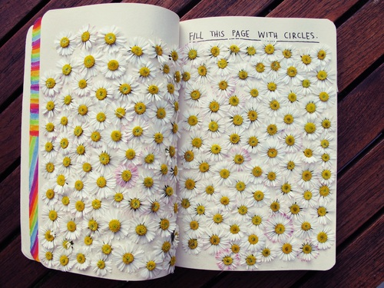
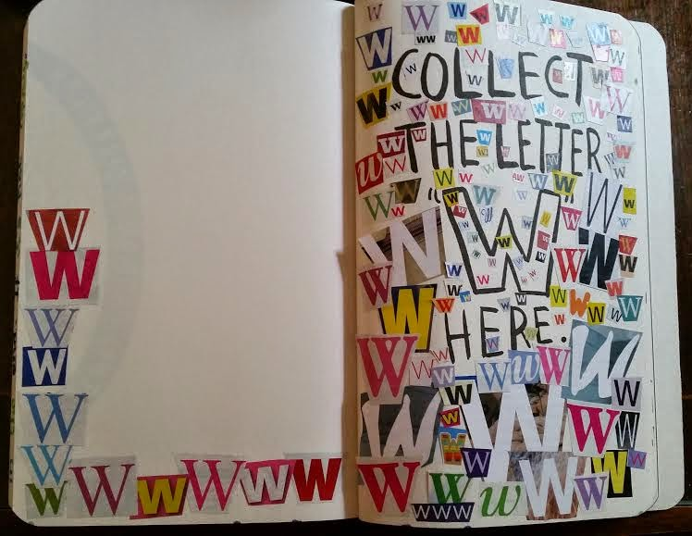
Photos from: clicks-clan.blogspot.com, tumblr.com

Slide 6
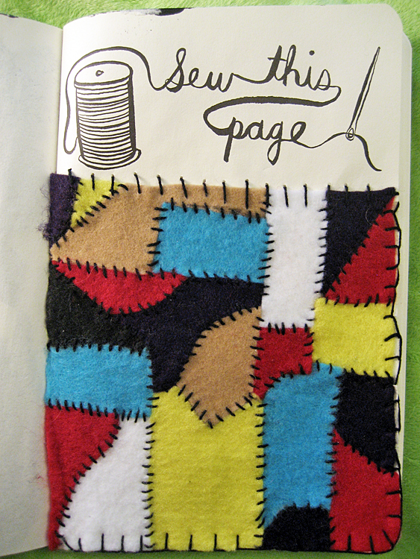
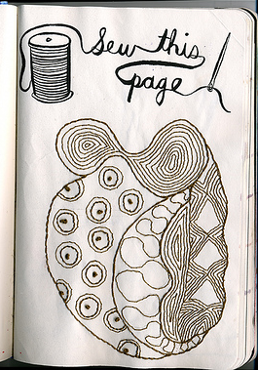
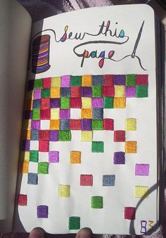
Photos from: justsomebroad.com, pintrest.com, flikr.com

Slide 7
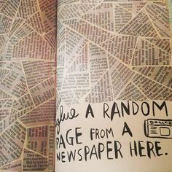
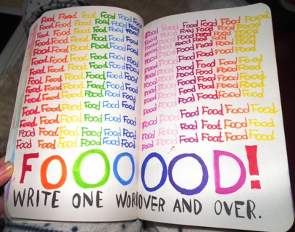
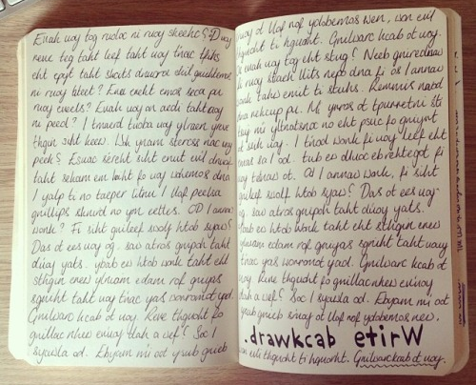
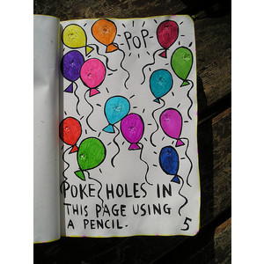
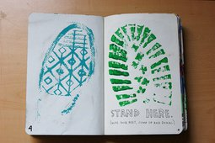
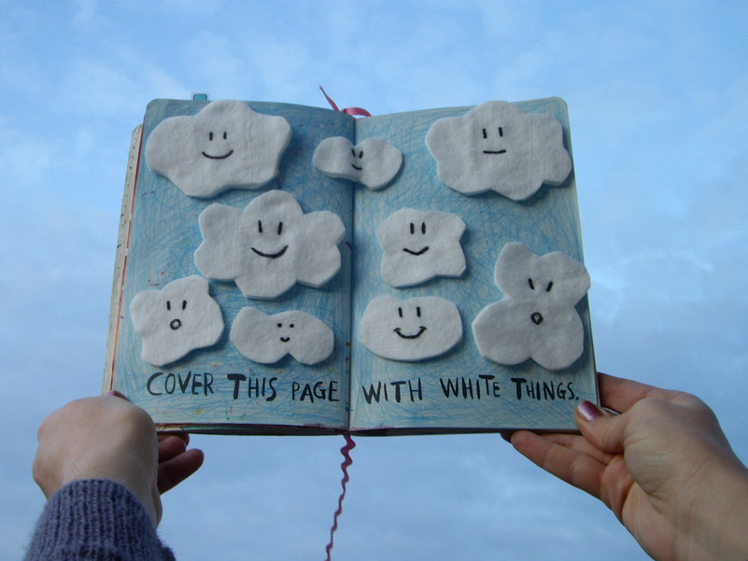
Photos from: pintrest.com, imgkid.com, polyvore.com, trendvee.com, tumblr.com

Slide 8
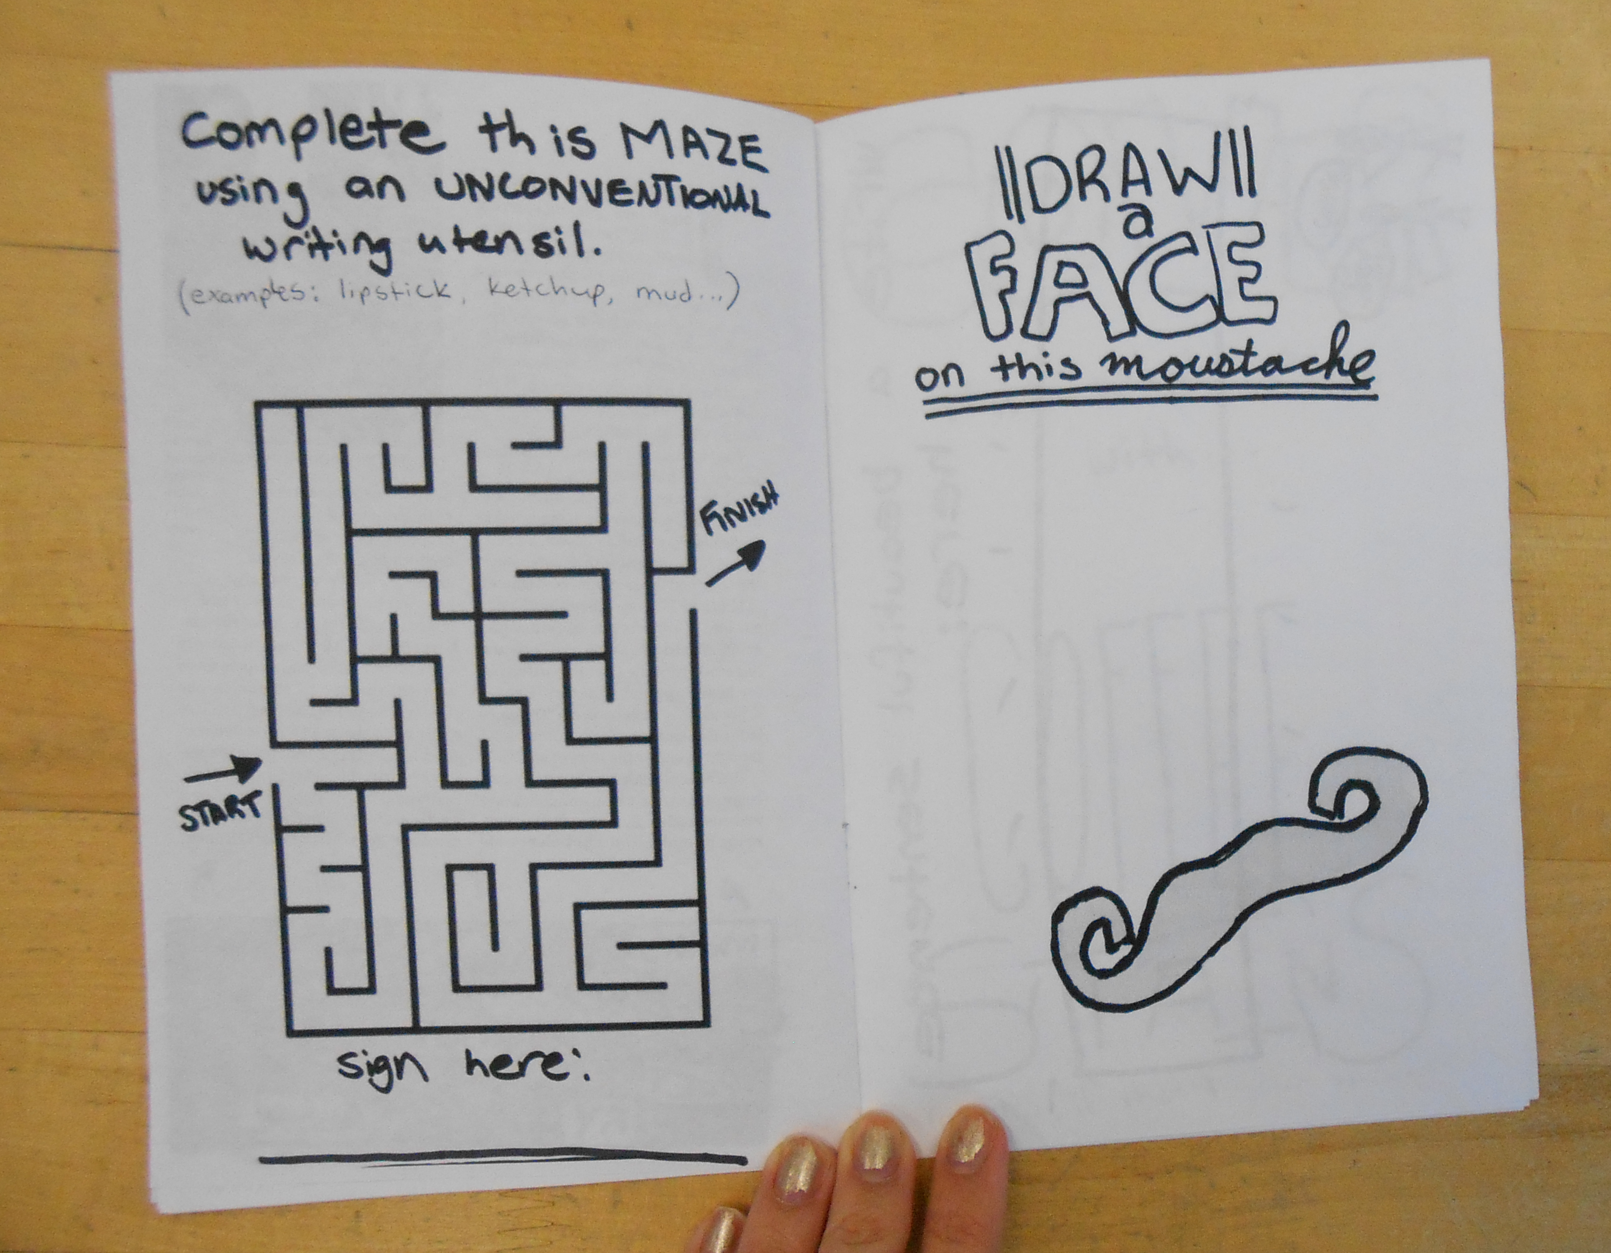
Are you feeling inspired yet?
Everyone gets to design their own pages of instructions for each other to complete! Go wild.
We’ll photocopy them all and create our own Idea Exchange Wreck This Journal that you can take home.
You can make your own cover if you want.
At the end we’ll sew it all together.

Slide 9

Time to Make Your Own Pages!
Ask yourself:
  What are some fun, unusual events that could be documented in a journal?
  How can I encourage people to think outside the box?
  What do I enjoy doing in my spare time, and how can I make that into a page?
Use the Inspiration Sheet for ideas!

Slide 10
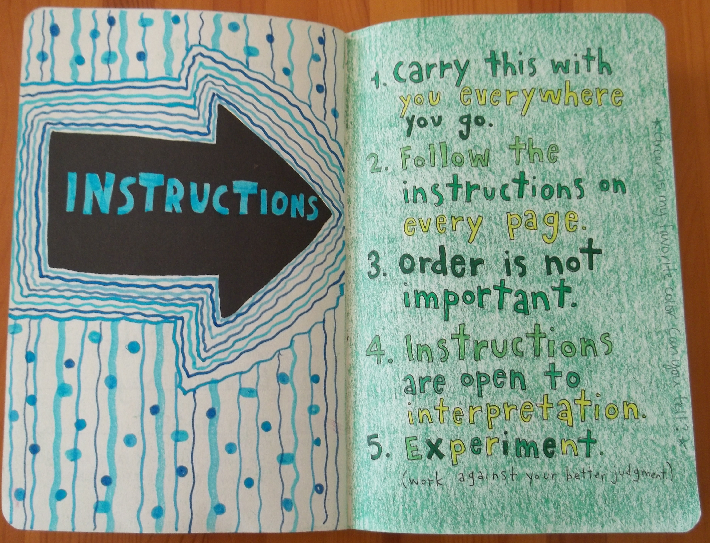
Rules? What Rules?
Wreck This Journal is about being creative and unique.
We’ll make our own rules.
They can (and should) be silly, and fun to follow.
Example: Journal may be completed in any order
5 bonus points per pun written in journal
Your turn!
Photo from: cbwentworth.wordpress.com

Slide 11


Slide 12

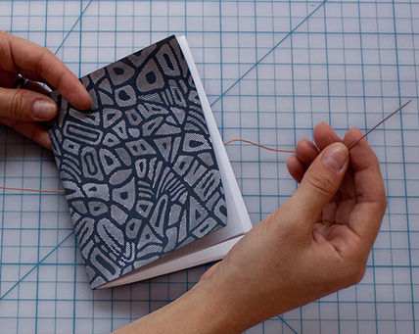
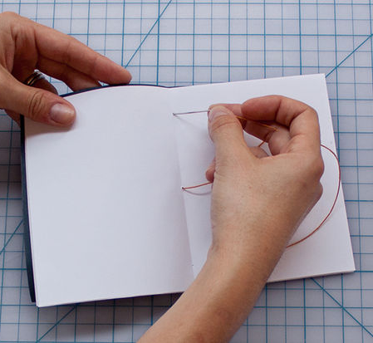
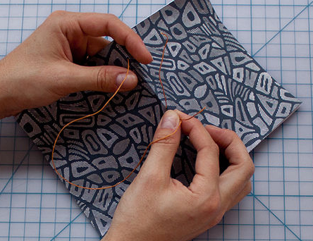
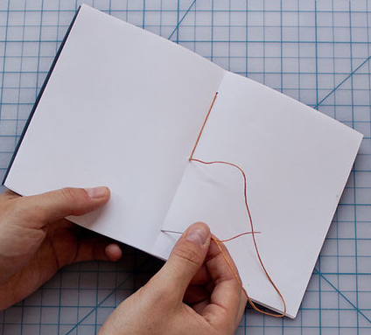
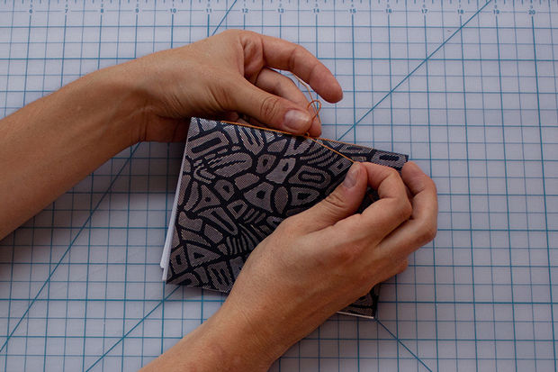
Book Binding
instructables.com
Poke 3 holes in spine Thread string through middle hole Thread string through top hole (from outside) (from inside)
Thread needle back through Thread string through bottom hole Tie a bow! You’re done!
middle hole (from outside) (from inside)

Slide 13
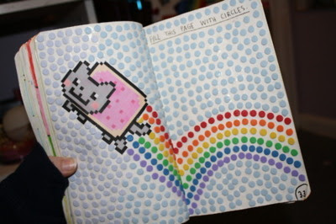
Now Do something awesome with your journal!
inspire-magazine-online.wordpress.com

