Slide 1
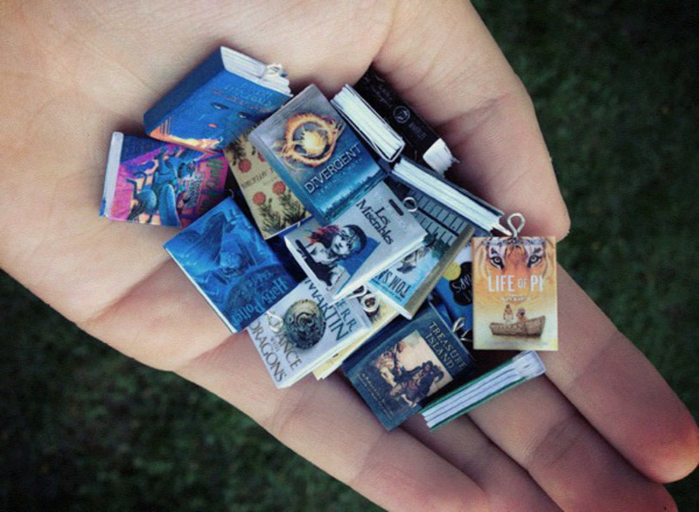
Tiny Book Workshop!

Slide 2


















Step 1: Pick your Tiny Book
Choose a book to make and cut out the tiny front cover and the tiny back cover

Slide 3
Step 2: Cut out a template
Choose the colour you’d like the spine of the book to be, and cut out one template along the outside lines.

Slide 4
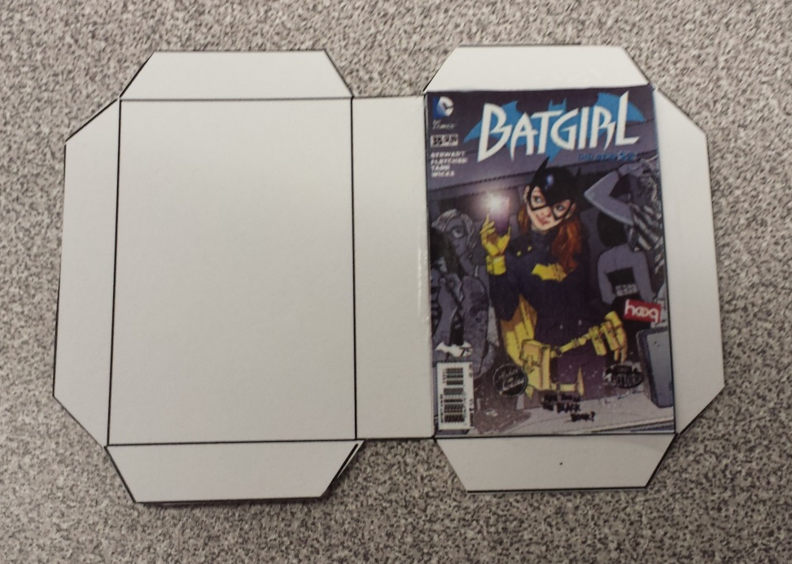
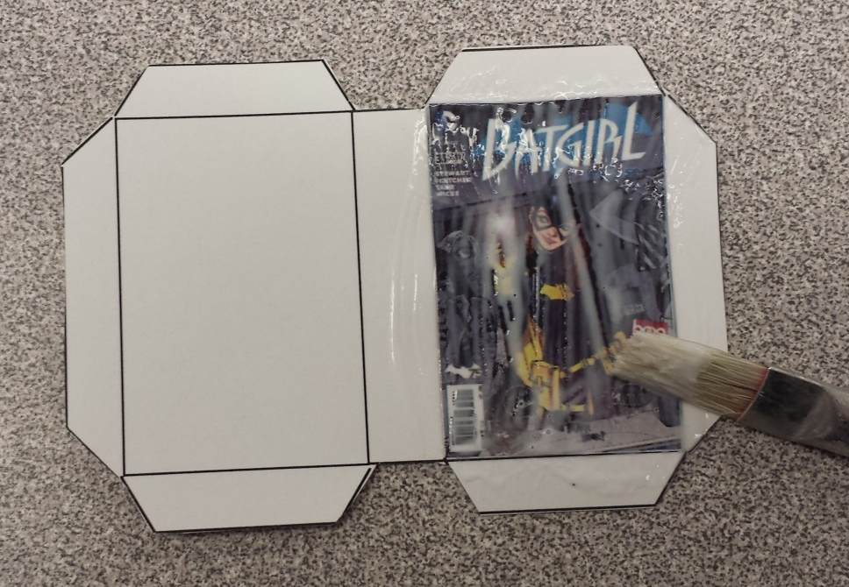
Step three: Seal on the covers
- Glue the front cover on the right side of the template, and the back cover on the left side.
- Brush Mod Podge on top of the covers.
- Set aside to dry.

Slide 5
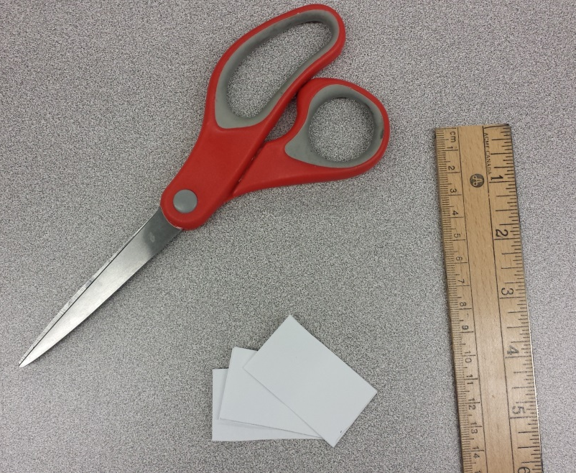
Step four: Cut the Inside Pages
Take a stack of 4 – 8 sheets of white paper
Cut out a small stack that is approximately 5cm wide and 4cm tall
Fold in half

Slide 6
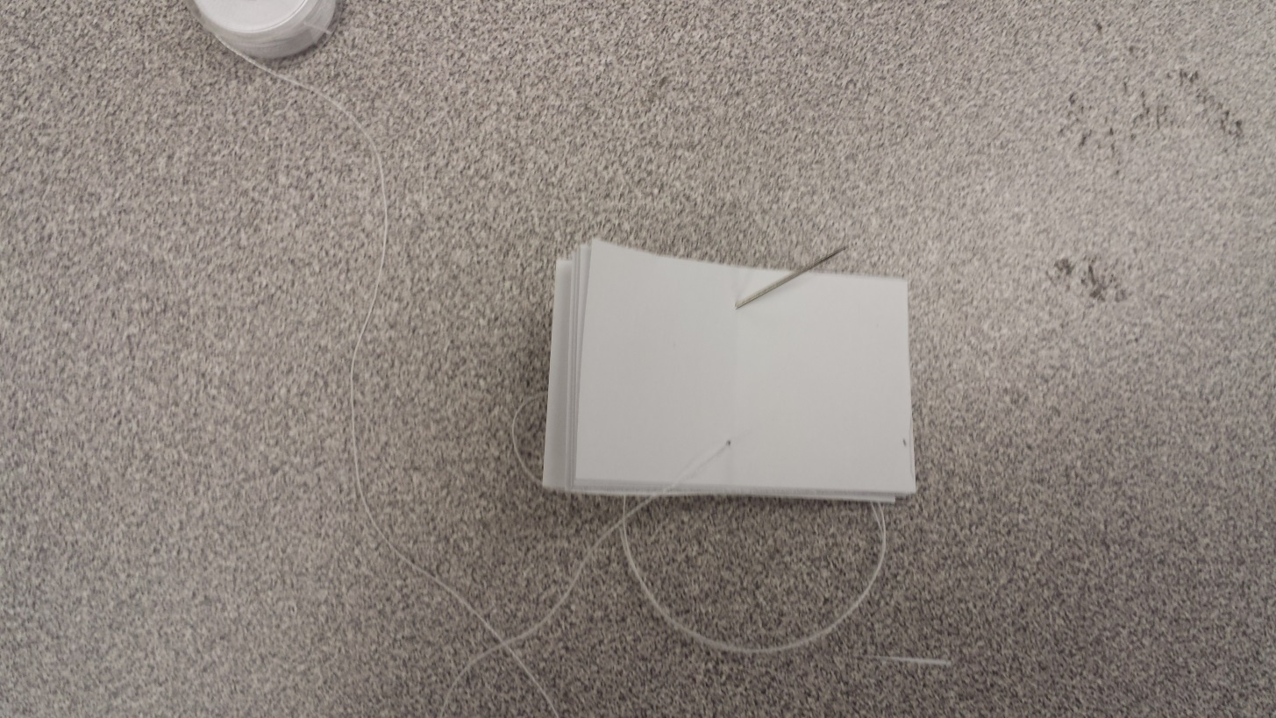
Step Five: Sew the pages
Push one end of thread through the eye of a needle
Push the needle through cut stack of paper, near the top of the folded middle line, and pull thread through

Slide 7
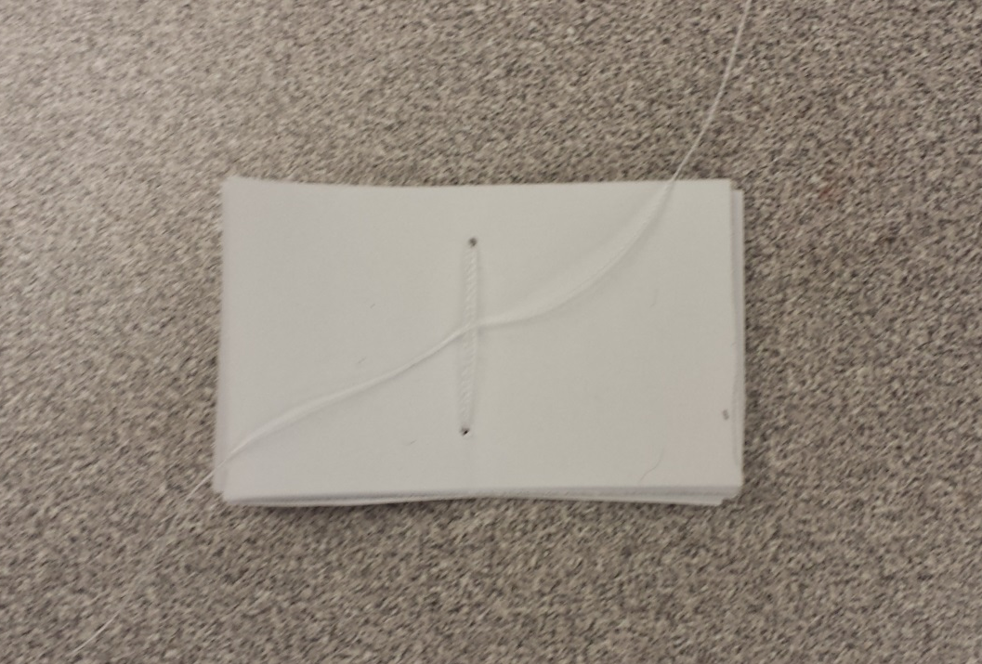
Step five Continued
- Use the threaded needle to push through a new hole below the 1st hole, near the bottom of the folded line
- Thread the needle through the top hole and the bottom hole 2 or 3 more times, securing the binding.
- Cut the thread , and tie both ends together

Slide 8
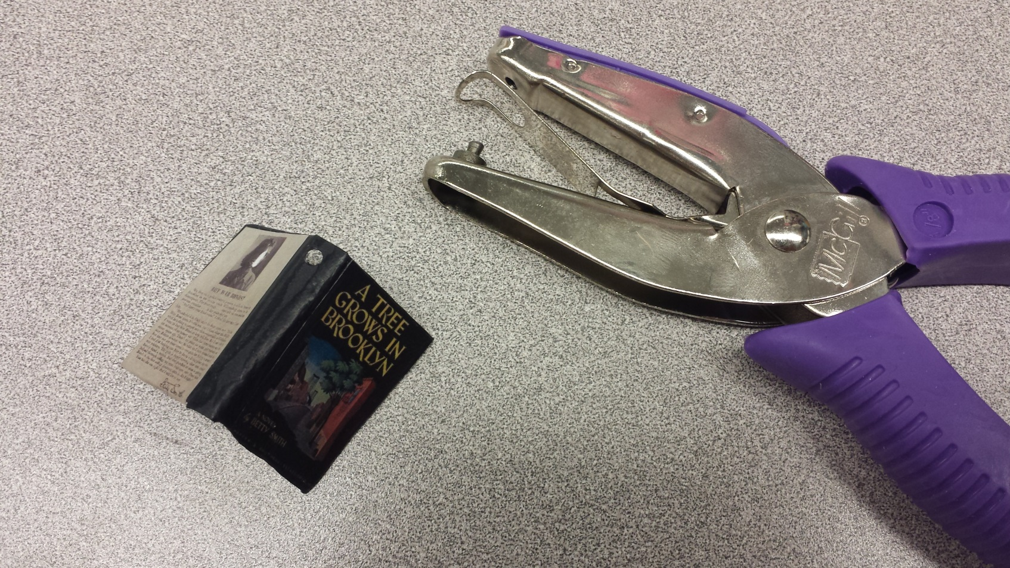
Step six: Punch a hole
- Use the small hole punch to punch a hole in the cardstock, near the top of the spine

Slide 9
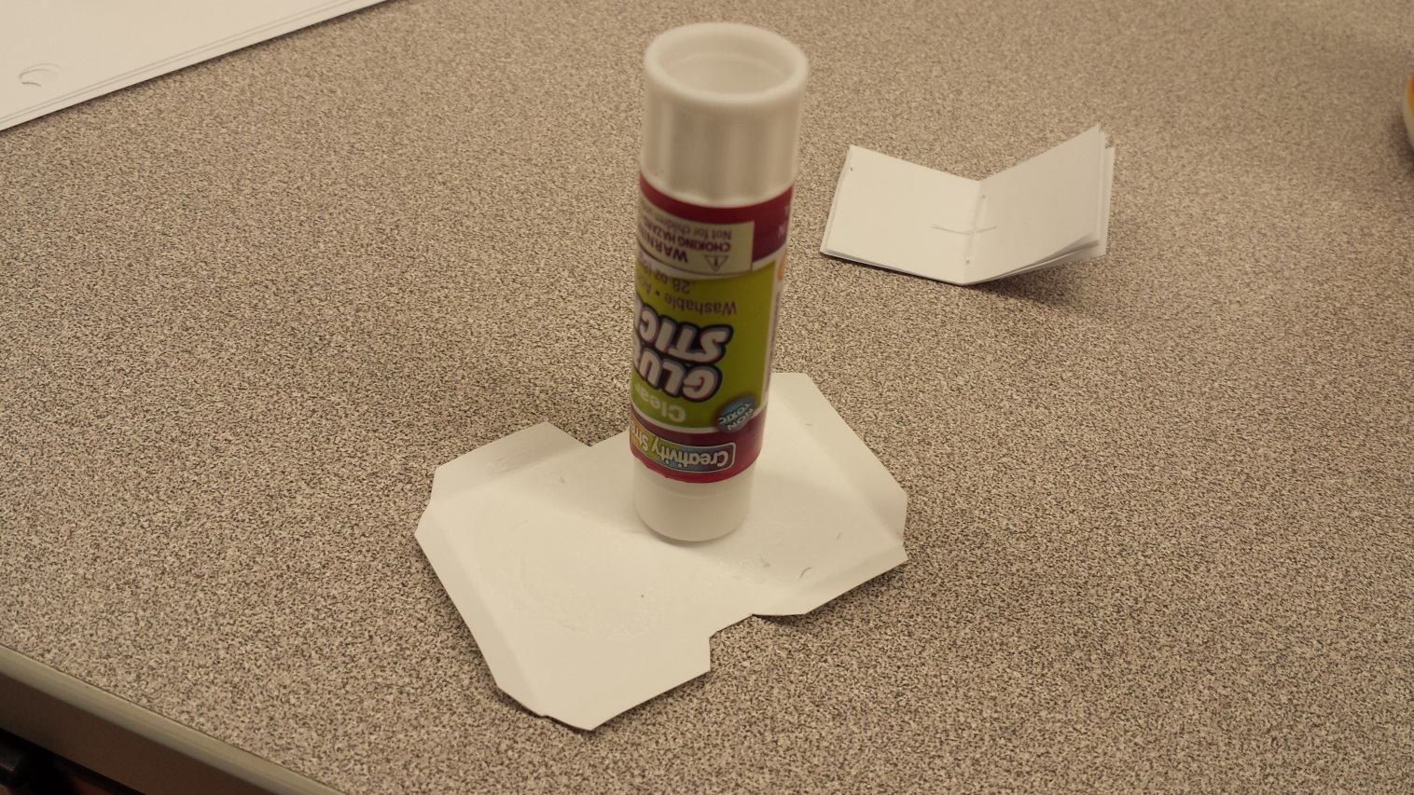
Step Seven: attaching the pages
- Fold all the flaps on the lines
- Flip the cardstock cover piece upside down, and apply glue to the entire back side

Slide 10
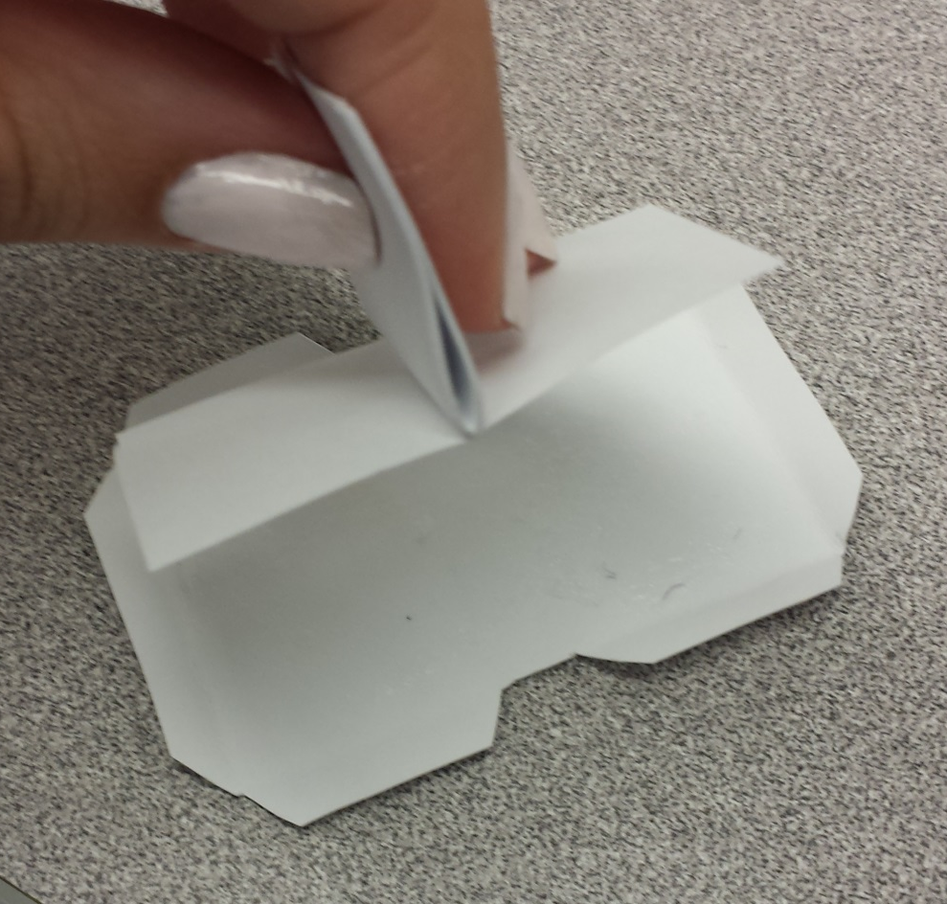
Step Seven Continued
- Press the front and back page from your bound booklet onto the glue on the cardstock cover

Slide 11
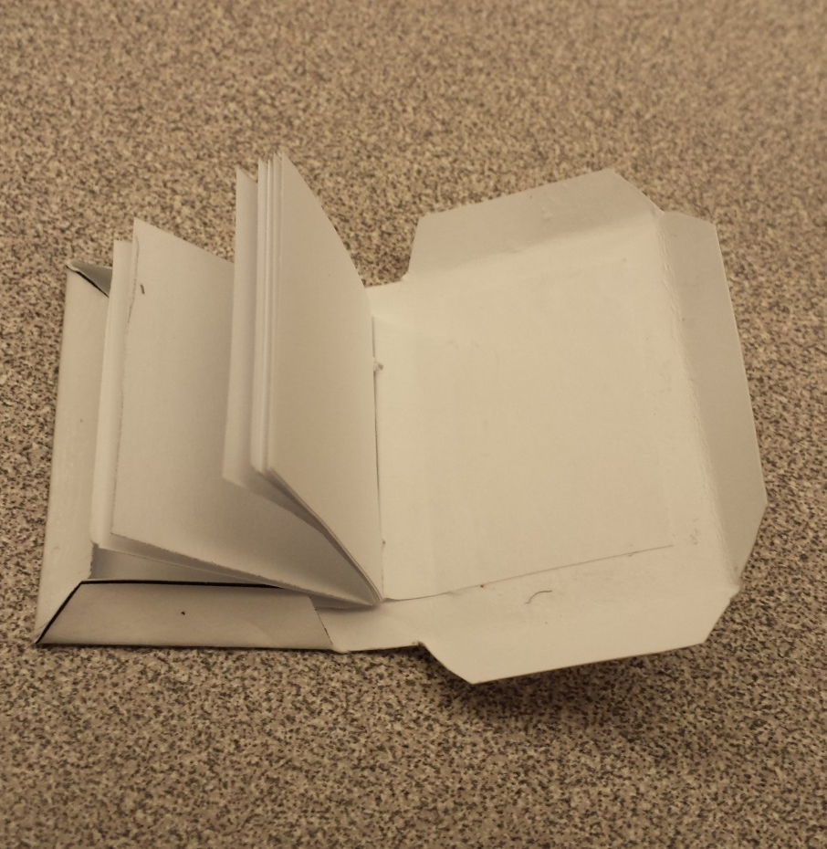
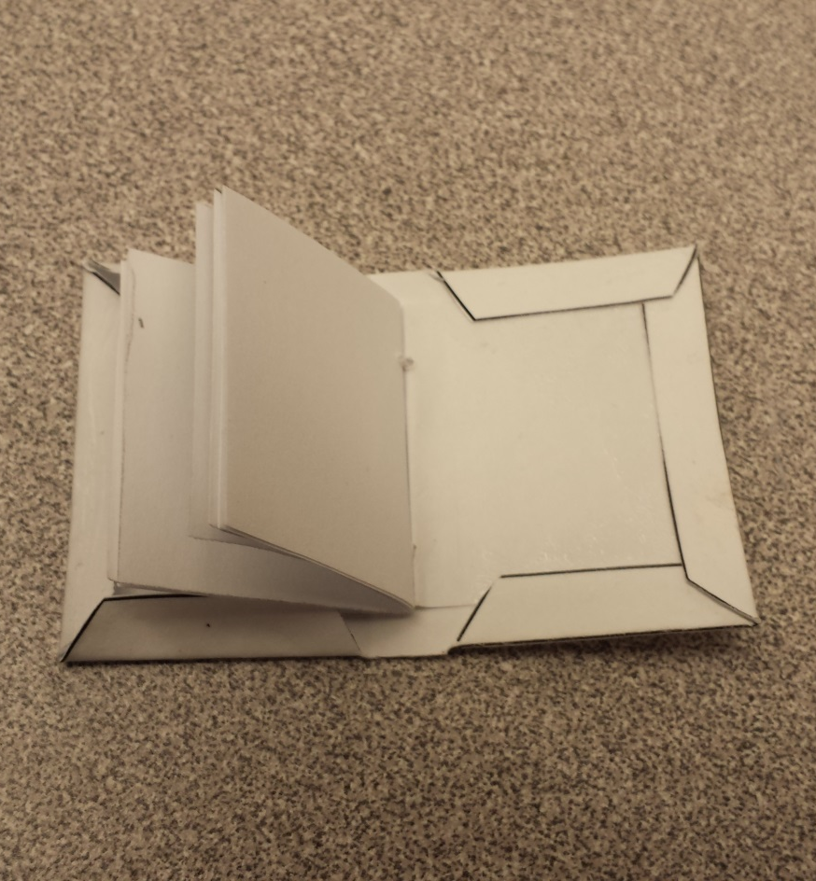
Step Seven Continued
- Fold the flaps onto the front and back pages, and press them firmly. Apply more glue if necessary.

Slide 12
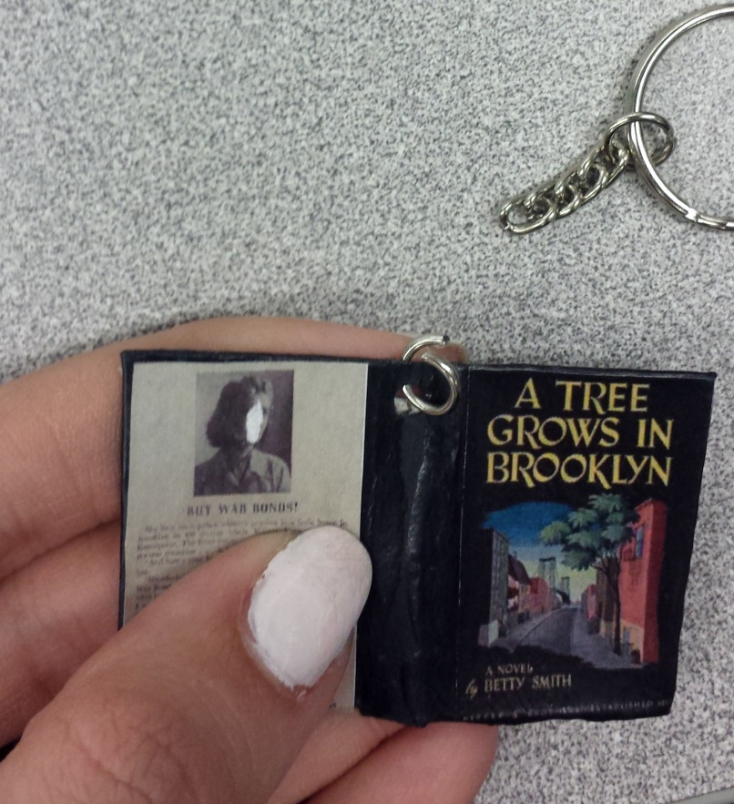
Step Eight: Attach to Jewelry
- Once dry, put a jump ring through the hole in the spine AND through a necklace cord, keychain, or earring.
- Use pressure or plyers to close the jump ring

Slide 13
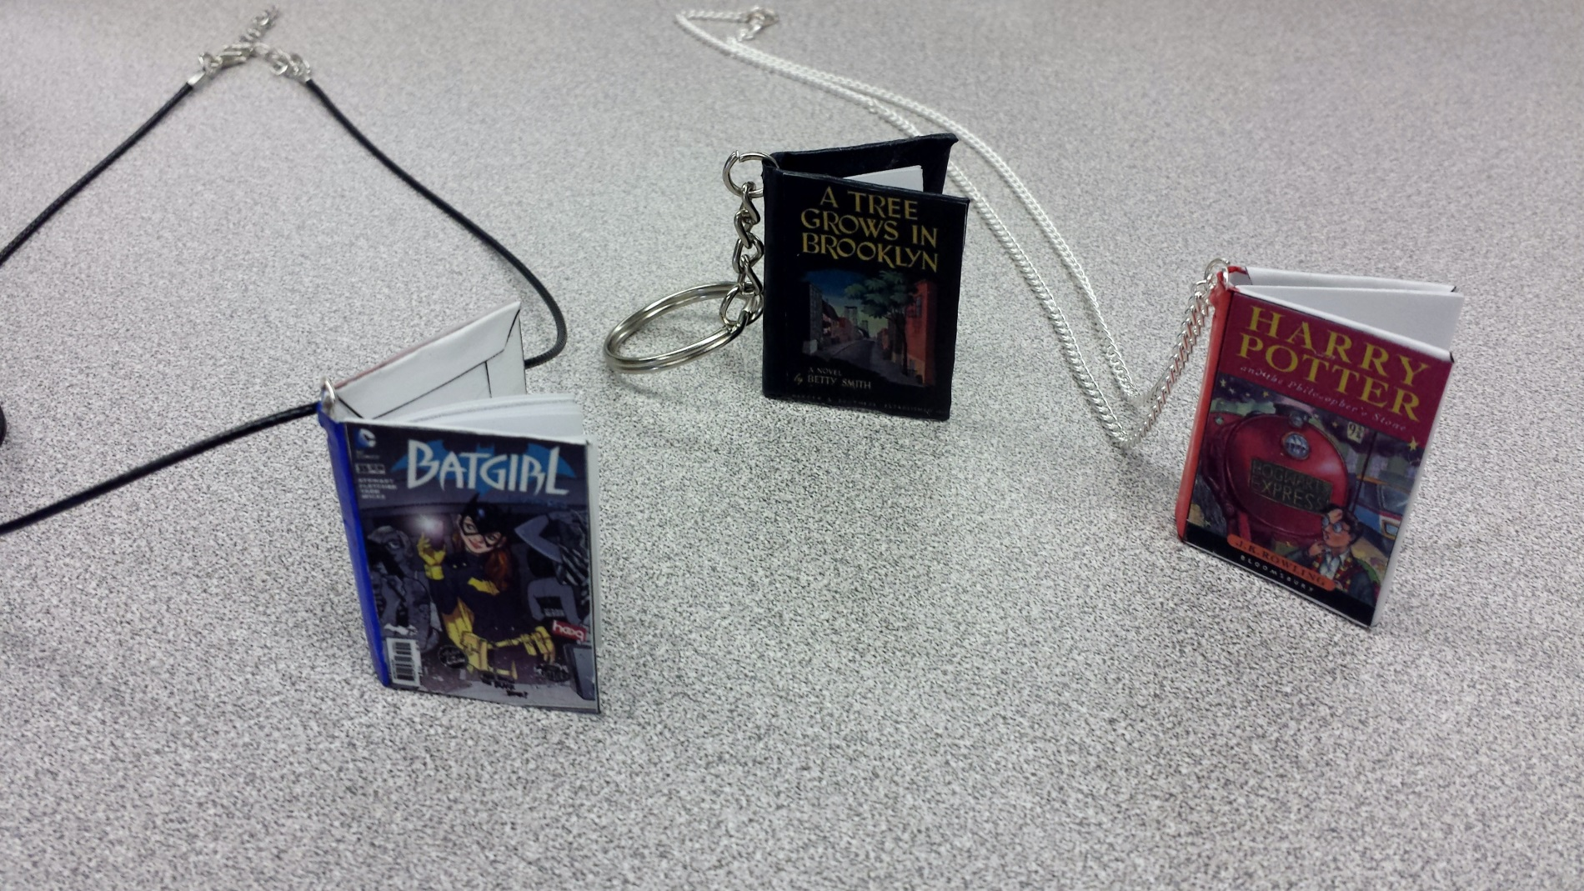
Enjoy your tiny books!

