Slide 1
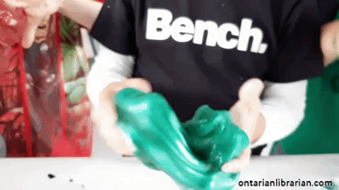
How does Slime work?

Slide 2
You only need two things to make slime!
1. polyvinyl alcohol (PVA)
2. borate ion
The 2 chemicals attach to each other, and form a long molecular chain. That’s why when you pull on slime, it stretches instead of coming apart.
You can make slime out of any two ingredients that include those chemicals.

Slide 3
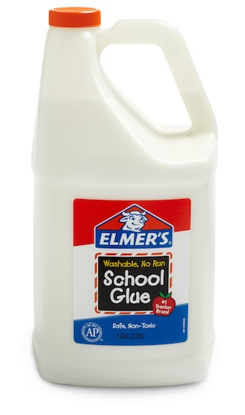
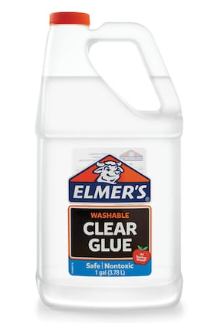
Polyvinyl alcohol (PVA)

Slide 4
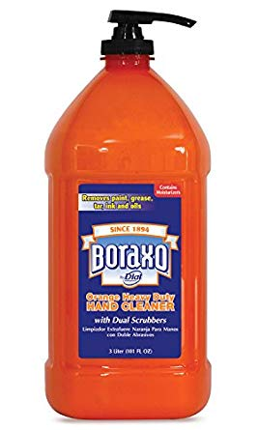
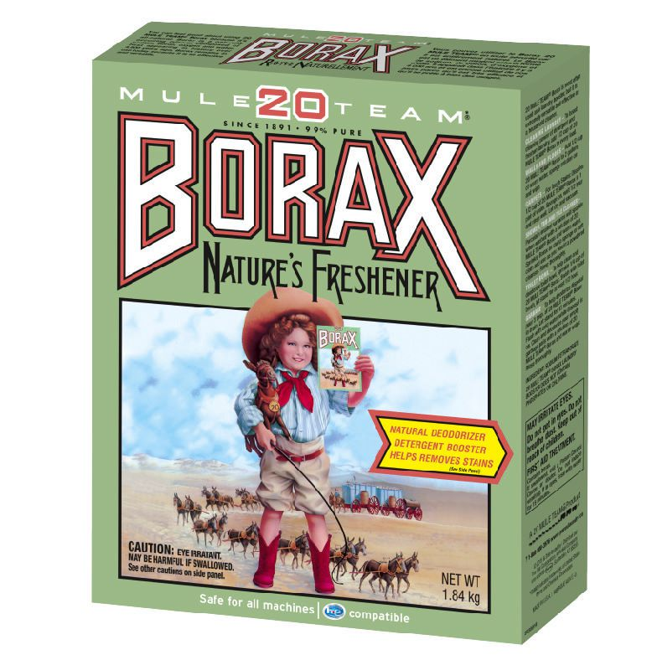
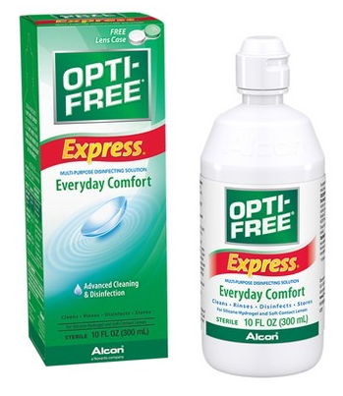
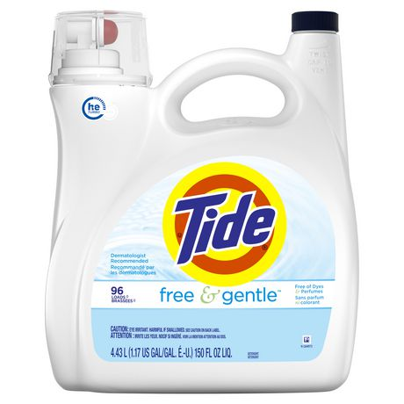
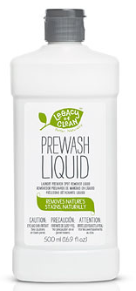
Borate Ion

Slide 5
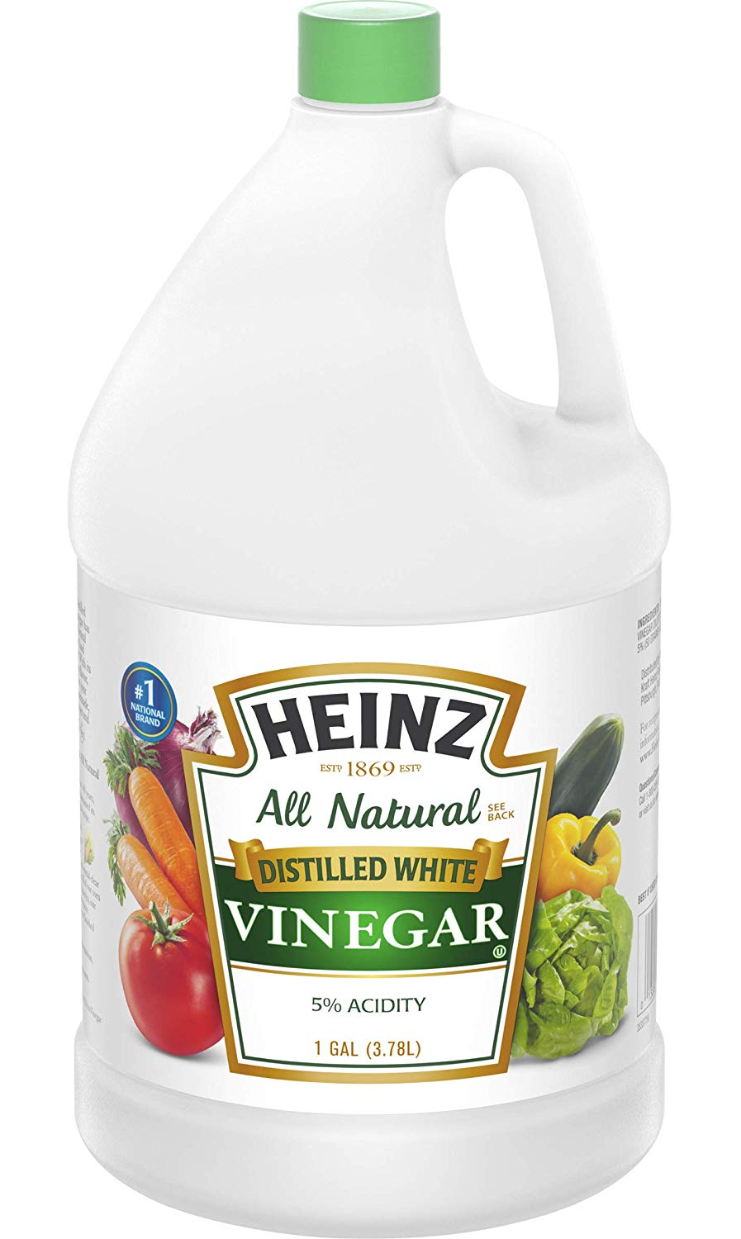
How to clean up slime
One secret ingredient will dissolve slime! Even if it’s stuck on your clothes.
Any guesses?

Slide 6
We are going to use:

Slide 7
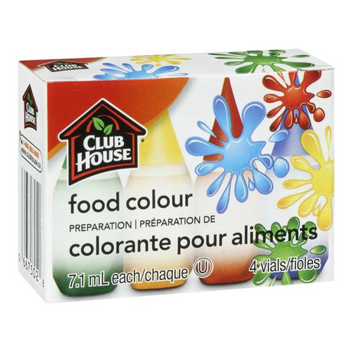
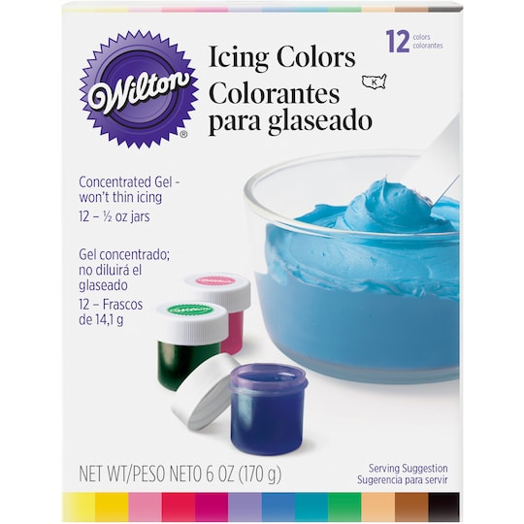
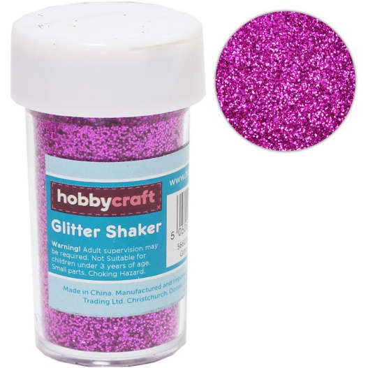
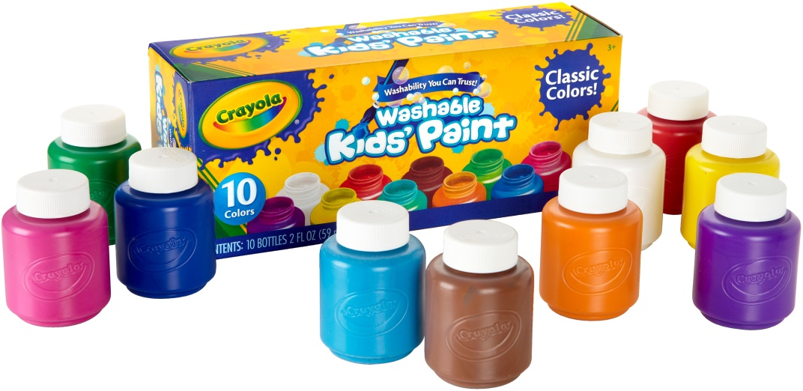
Colorants for Slime

Slide 8

We are going to use:

Slide 9
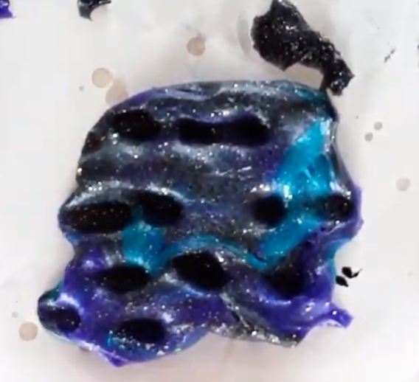
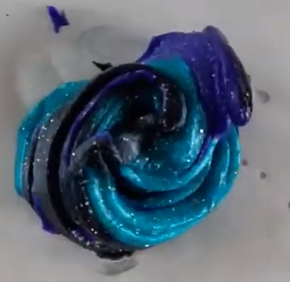
Space Slime!

Slide 10
Tips for your best space slime ever
Separate your slime into 2 – 4 sections, decorate them differently, then swirl together.
Plan out your colour scheme, including the glitter colour
  Glitter can change the colour of your slime
Think of colours that will blend well together
  For example, red and green turn brownish when mixed together. Pink and blue turn purple!

