Slide 1
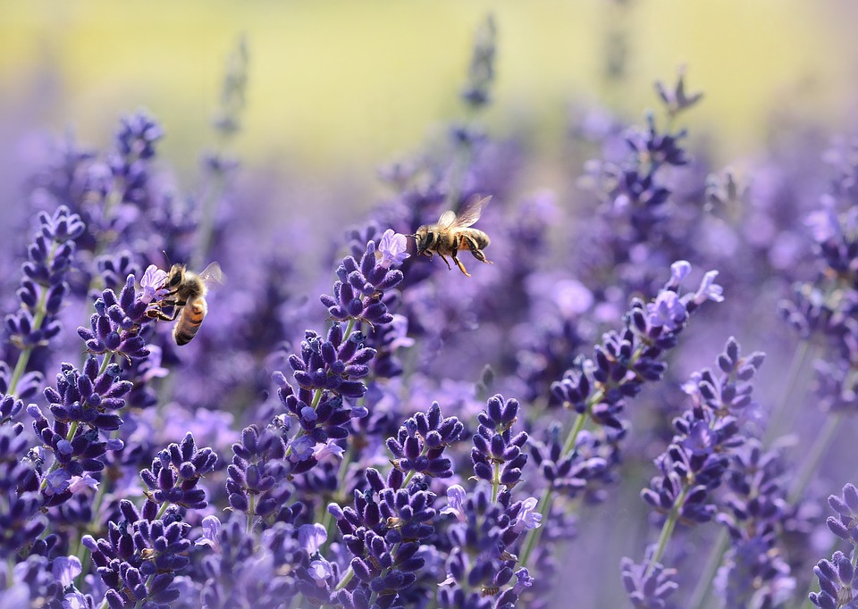
Un-BEE-lievable Science

Slide 2
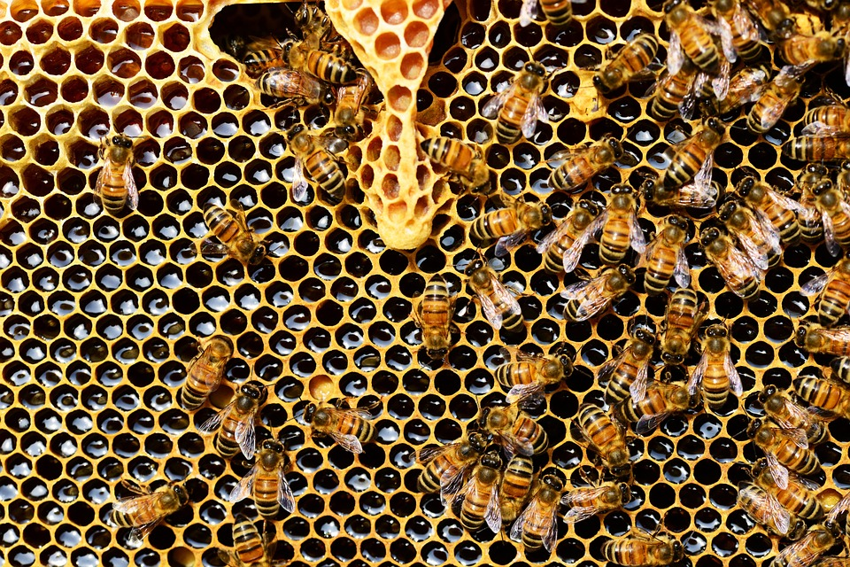
What do you know about bees?

Slide 3
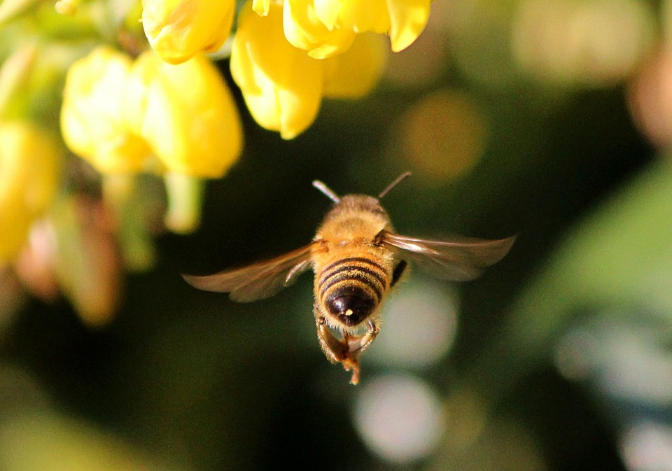
A bee beats it’s wings over 200 times per second
True! That is one wing beat every 0.005 second

Slide 4
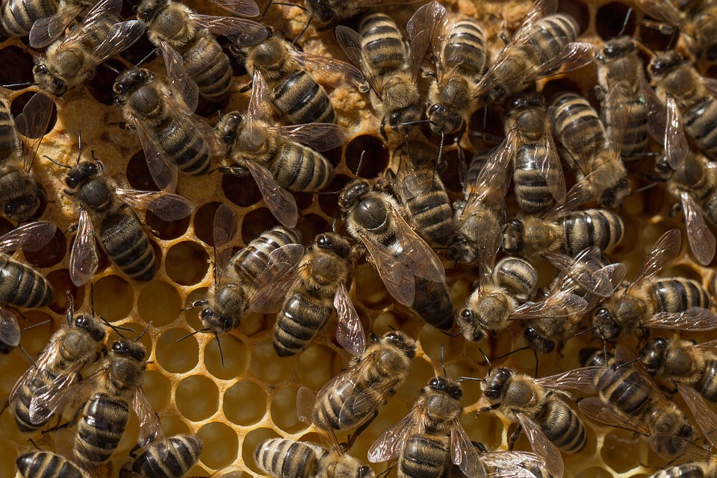
A queen bee lays over 10,000 eggs per day
False. But a queen bee does lay 2500 eggs per day!

Slide 5
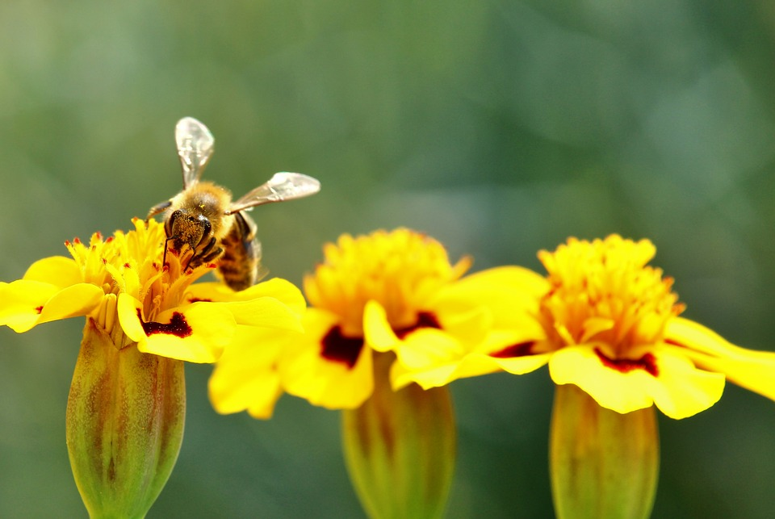
There are about 20,000 species of bees in the world
True. Honeybee, mason bee, carpenter bee, blueberry bee, etc.

Slide 6
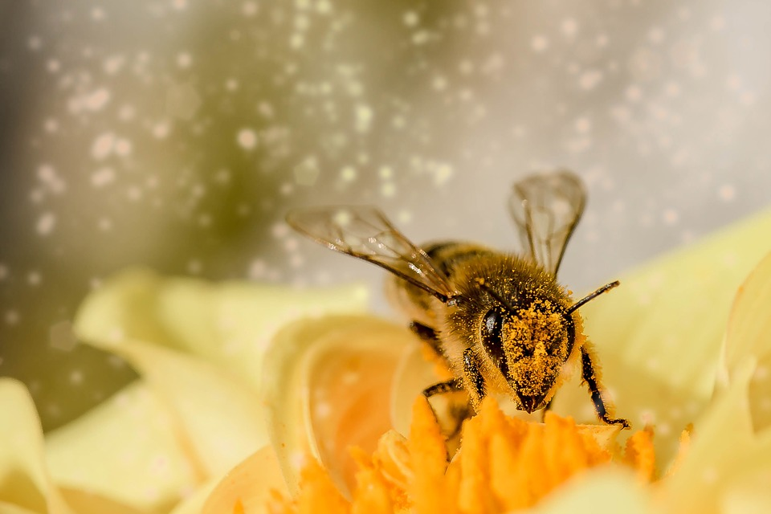
How does pollination work?

Slide 7
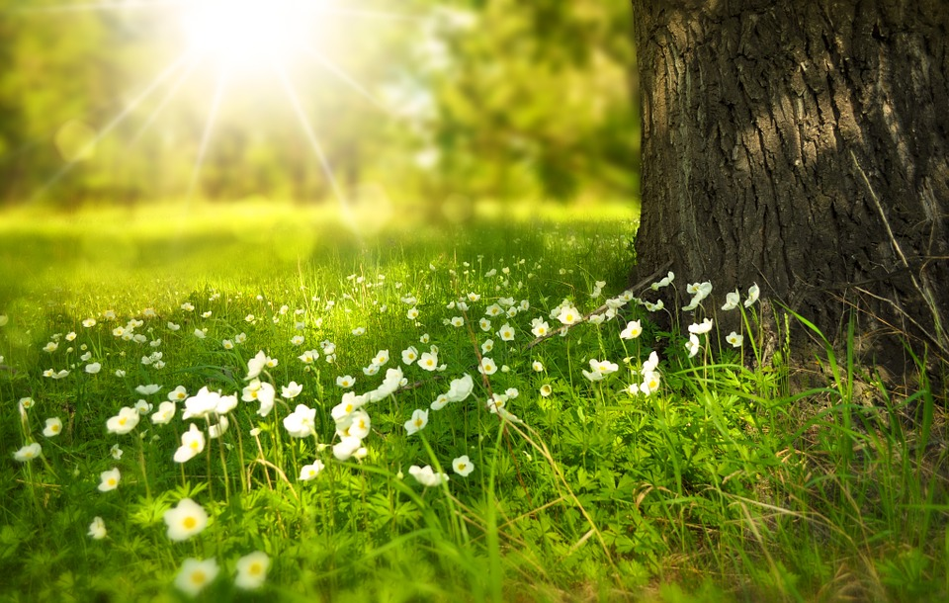
The fuzzier a bee is, the more pollen it can carry from plant to plant
Plants need the pollen of other plants in order to produce seeds
If bees disappear, plants will eventually disappear
Humans need plants to survive
  They are an important part of our ecosystem

Slide 8
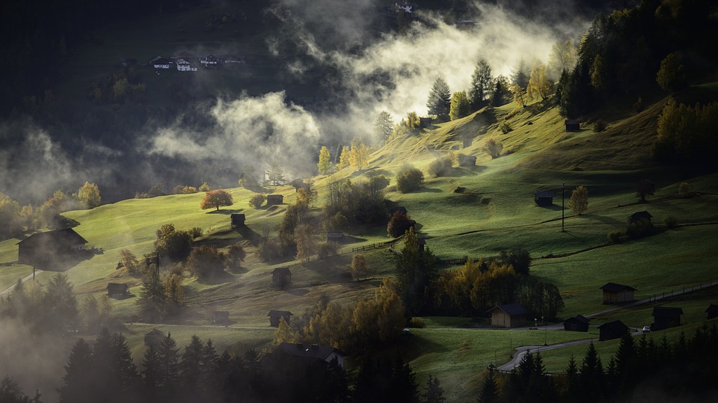
Why do humans need bees?
Because humans need plants.
  Food
    Crops that are pollinated by bees are larger and better
  Oxygen
    Plants take in carbon dioxide and produce oxygen
  Water
    Plants clean water and help remove pollution

Slide 9
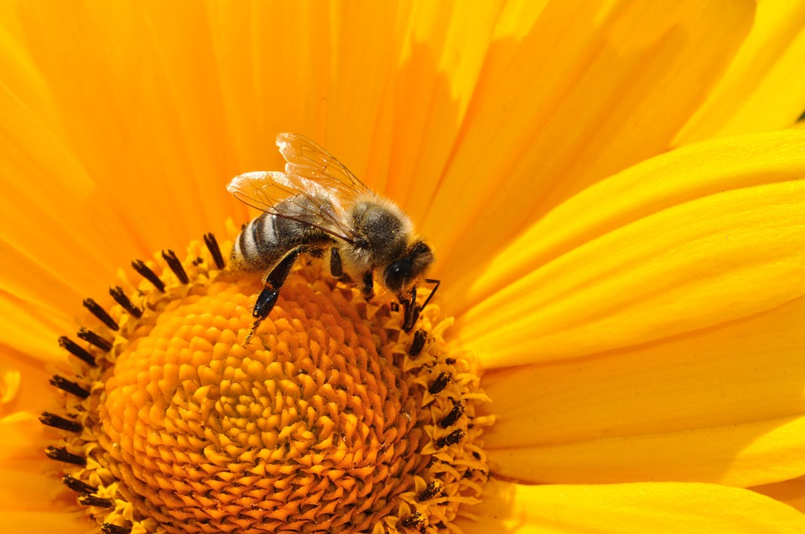
The Pollination Game!

Slide 10
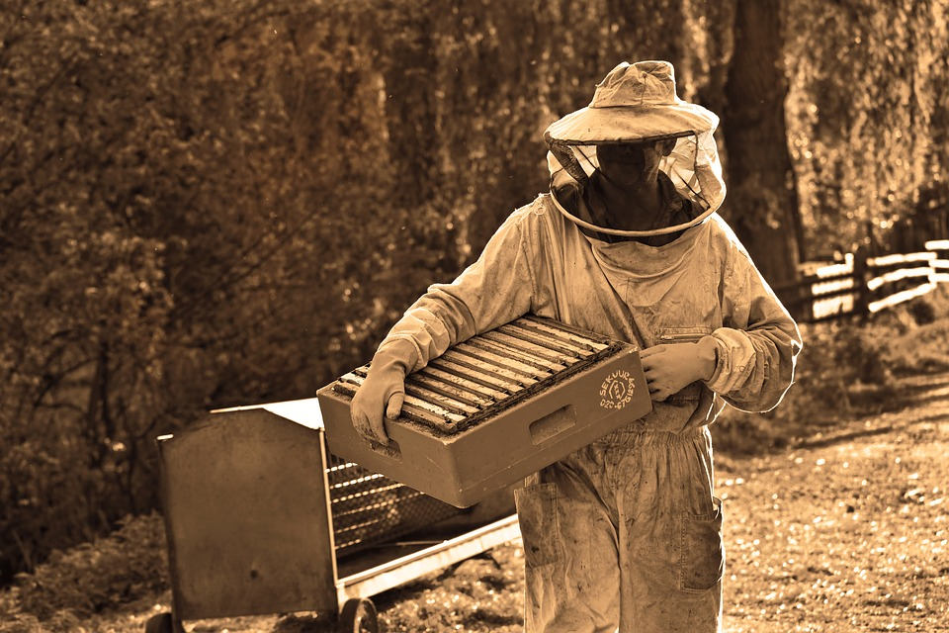
How does beekeeping work?

Slide 11
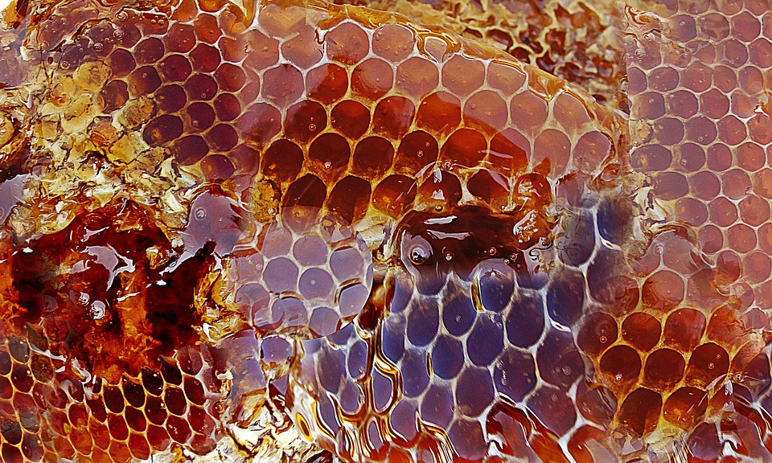
What IS Honey?

Slide 12
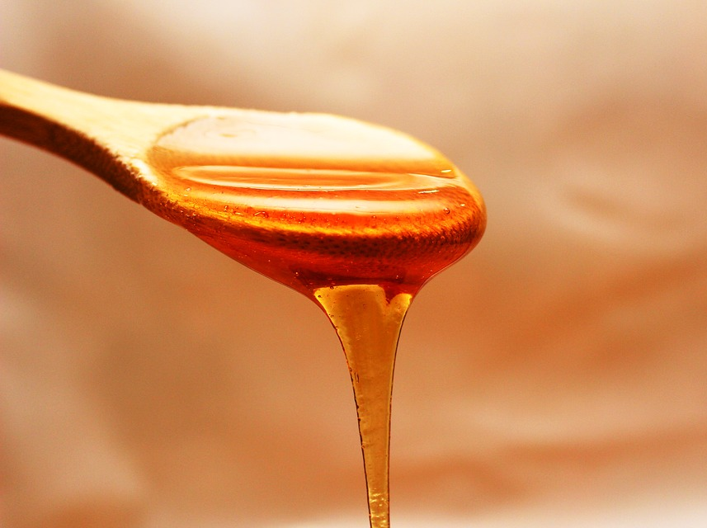
How is honey made?
Bees collect nectar from plants by eating it
  They store it in an extra stomach called a “crop”
Bees return to the hive and throw up all the nectar
  Multiple bees eat and throw up the nectar, until it is partially digested and ready for the honey comb.
Bees use their wings to fan the watery nectar and speed up evaporation

Slide 13
Once the nectar is thicker, bees seal the honey comb with beeswax.
Stored this way, honey can last forever!
Bees store honey to eat over the winter months when there is no fresh nectar to harvest.
Bees usually make much more than they need, which is why humans can harvest honey after the winter.

Slide 14
What does honey taste like?
Honey tastes sweet.
But if you focus on the flavour, you might be able to guess where the nectar came from.
For example, if the nectar came from peach trees, it has a slight peach flavour. If it came from wildflowers, it has a flowery flavour.

Slide 15
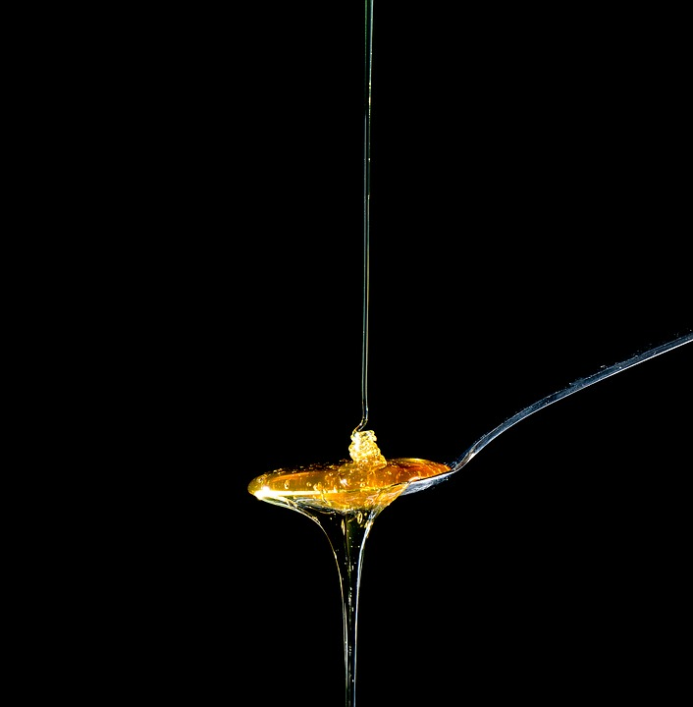
Honey Tasting!

Slide 16
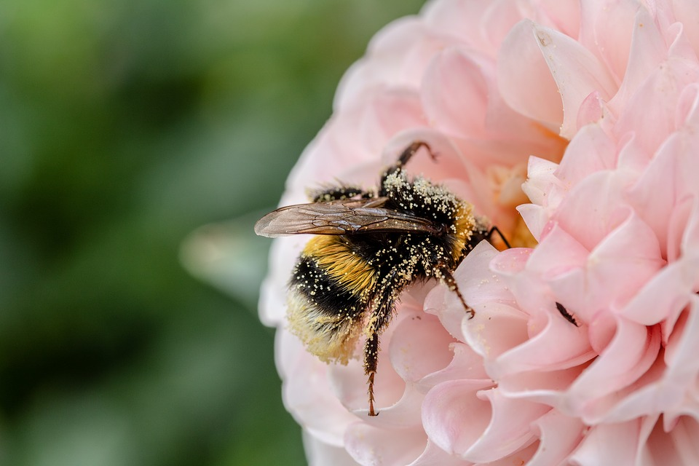
“Bee” Friendly to Bees

Slide 17
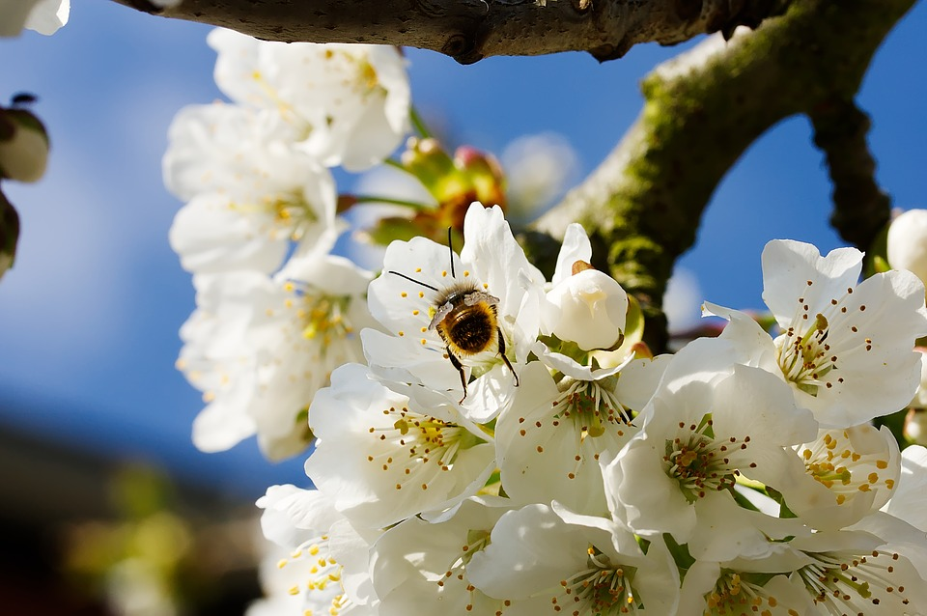
Bees like plants that are:
Full of pollen and nectar
Bright colours
  Especially blue, purple, white, and yellow
Easy to land on
Fragrant (the smellier the better!)

Slide 18
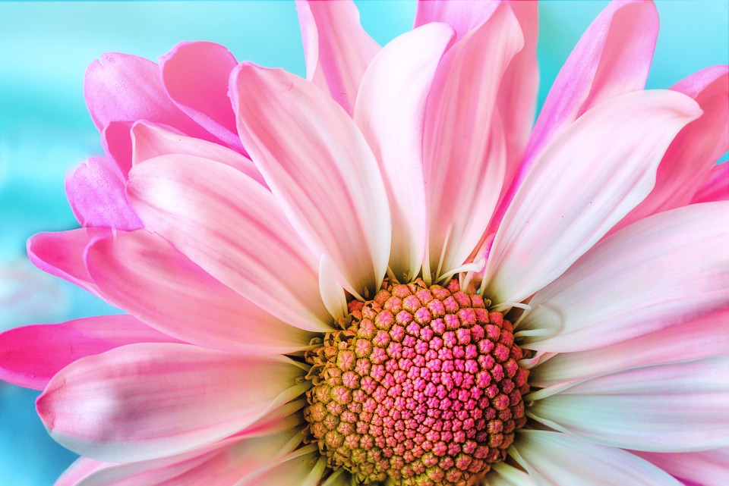
The Flower Challenge

Slide 19
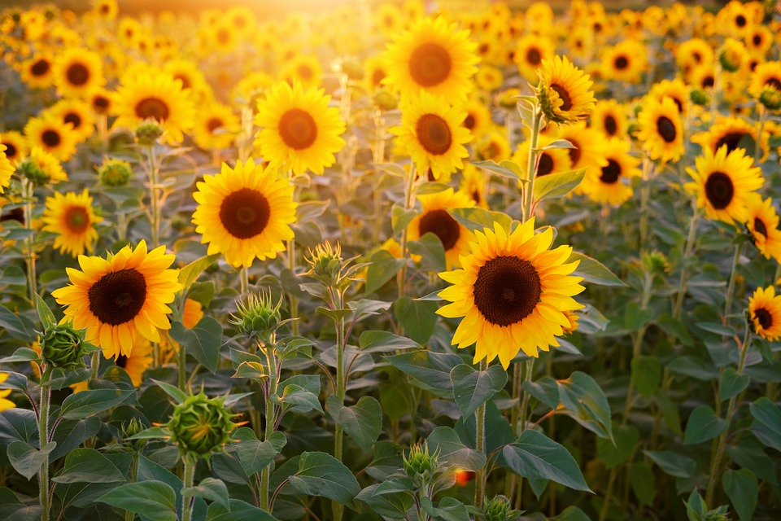
Yes! This is bee friendly.
Yellow and easy to land on
Sunflower

Slide 20
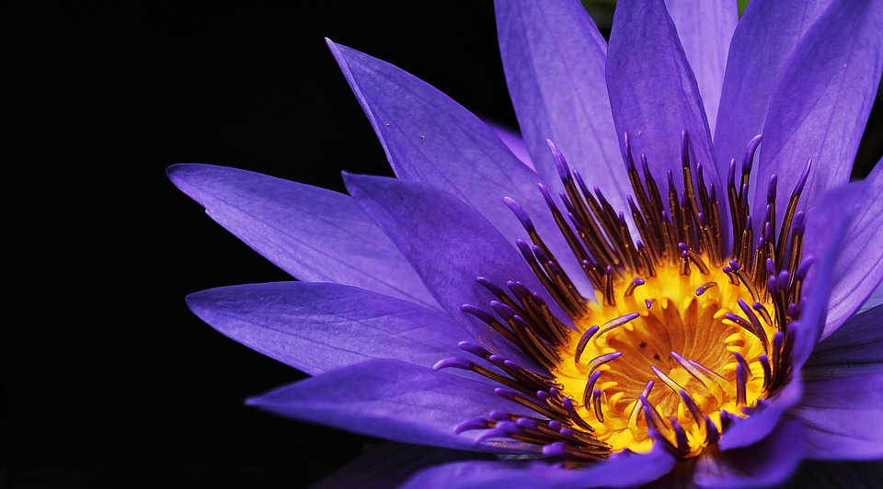
Yes! This is bee friendly.
Purple and easy to land on
Water Lily
Has to be very attractive to bees so that they’ll risk flying over the water

Slide 21
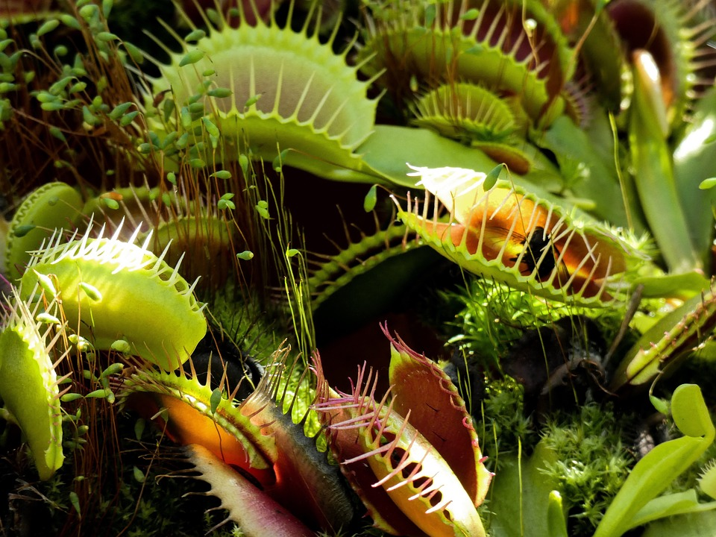
No! Not bee friendly.
It eats bees!
Venus Fly Trap

Slide 22
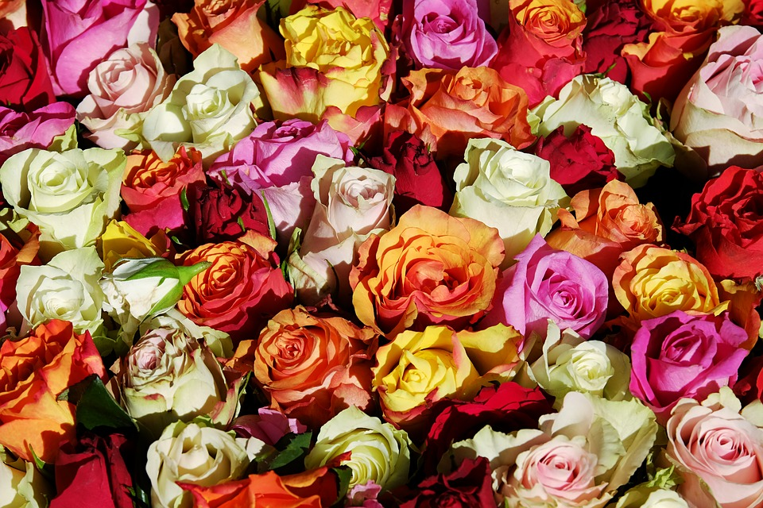
Yes! This is bee friendly.
Bright and very fragrant
Roses

Slide 23
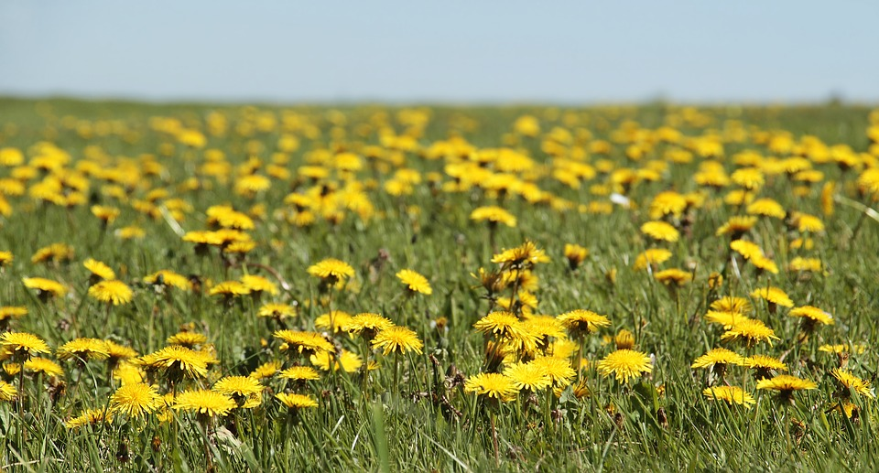
Yes! This is bee friendly.
Bright and easy to land on
Very easy to find
Dandelion

Slide 24
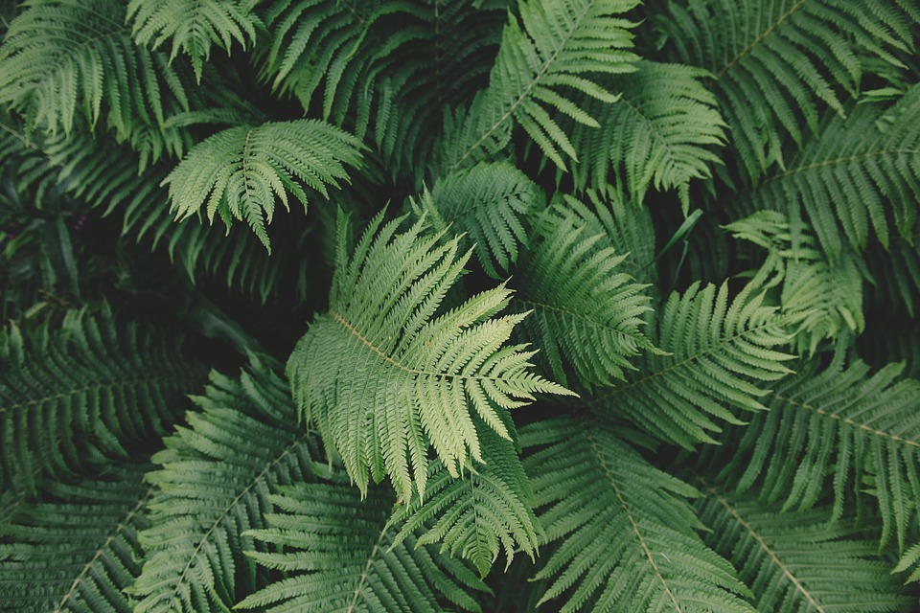
No! Not bee friendly.
No pollen or nectar. Not bright.
Fern

Slide 25
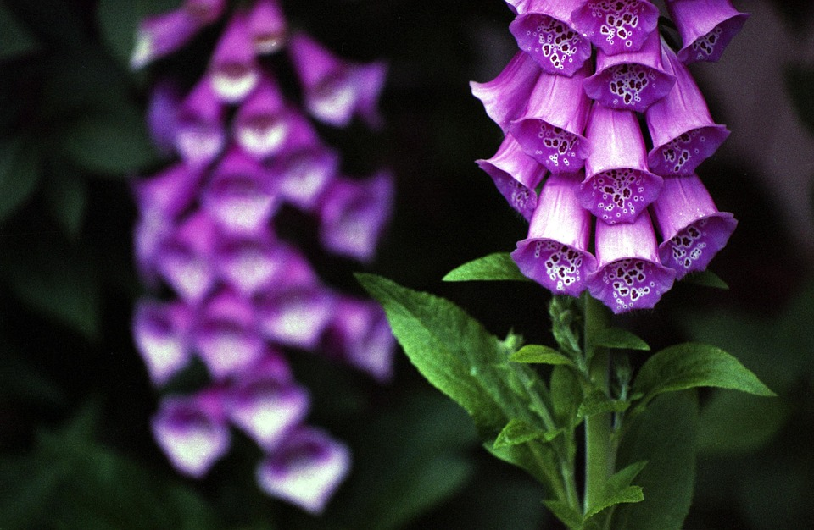
Yes! This is bee friendly.
Bright and easy to land on
Foxglove

Slide 26
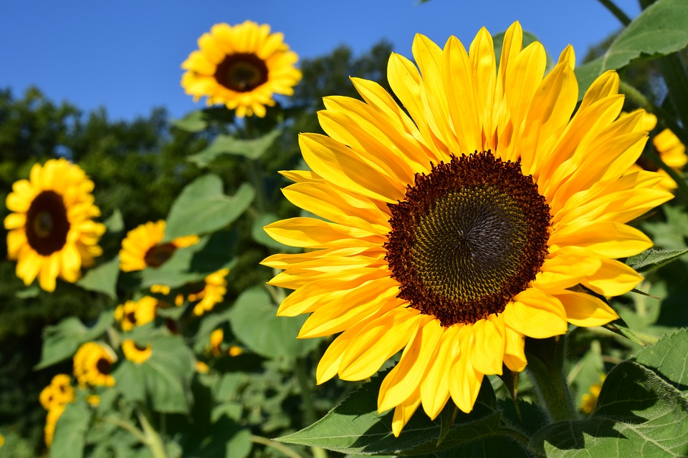
Start your own bee garden

