Slide 1
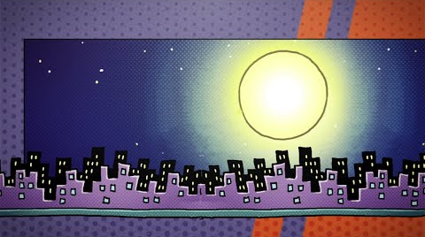
Which Dog Man Character Are You?

Slide 2
1. What is your favourite food?
Gum
Pizza
Apples
Rotten meat

Slide 3
2. What is your favourite animal?
Dolphins
Dogs
Kittens
Evil crows

Slide 4
3. Why do you like Dog Man books?
They are really funny.
They are exciting.
I love the characters!
Nothing I hate them and I hate Dog Man

Slide 5
4. What are you like in school?
The class clown: you love pulling pranks and sometimes have trouble paying attention
The hero: you stand up for what’s right and make sure everyone is getting along
The good friend: everyone likes you and you are nice to everyone
Diabolical: you’re a bad guy and you should go to jail

Slide 6
5. What is your favourite colour?
Green
Blue
Every colour!
Darkness

Slide 7
6. What is your favourite hobby?
Drawing
Sports
Smiling
Being mean

Slide 8
7. What word best describes you?
Creative
Brave
Sweet
Atrocious

Slide 9
8. Which Dog Man book do you like best?
Fetch-22
The first one! Dog Man.
Dog Man and Cat Kid
NONE OF THEM

Slide 10
RESULTS!

Slide 11
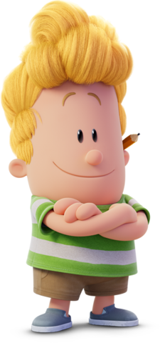
If you got Mostly As you are….
Harold!

Slide 12
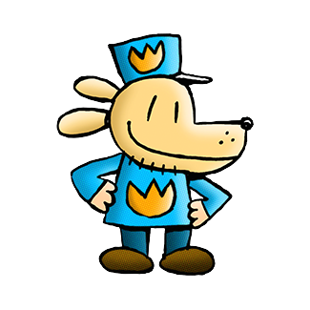
If you got Mostly Bs you are….
Dog Man!

Slide 13
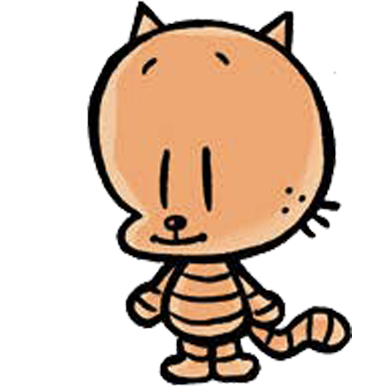
If you got Mostly Cs you are….
Li’l Petey!

Slide 14
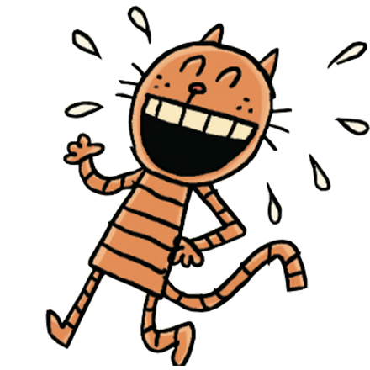
If you got Mostly Ds you are….
Petey!

Slide 15
Mostly As: You are Harold - one of the creators of Dog Man! You are a creative person with lots of passion. You love to draw, and you have unique interests and opinions. Keep being you!
Mostly Bs: You are Dog Man – the hero of the story! You are a brave person who sticks up for those in need. You try your best to be mature, although you have a silly side too. Never stop standing up for what’s right!
Mostly Cs: You are Li’l Petey – the baby clone of Petey! Everyone likes you and you get along with everyone. You are innocent and fun-loving, possibly a younger sibling, and you do your best to make sure everyone is happy. Keep being a good friend.
Mostly Ds: You are Petey – the villain! What?! Did anyone really get this result? You have a very silly sense of humor and you like the unexpected. Don’t be a villain you sillyhead! Do keep being funny and surprising.

